Slide 1


PROJECT Caribbean Multichoice
QUALITY CONTROL REPORT
IPSOS KENYA
© Ipsos | Caribbean Multichoice | December 2024 | Quality Report | Version 1 |

Slide 2
01
01
BACKGROUND & OBJECTIVES
02
02
METHODOLOGY
CONTENTS
03
QUALITY ASSURANCE
03
04
QUALITY CONTROL FINDINGS
04
05
CHALLENGES
05
06
06
RECOMMENDATIONS

Slide 3
BACKGROUND AND OBJECTIVES
01

Slide 4
BACKGROUND AND OBJECTIVE
Study Objective
The study was designed to understand the behaviour of consumers when accessing and using TV and video content services.
It was a tracker that targeted different areas as stated below:
Viewing devices: Identified the devices consumers use to watch TV and video content, such as smart TVs, smartphones, tablets, or laptops.
Services accessed: Analyzed the specific streaming or broadcast services that consumers frequently use to watch TV and video content.
Viewing behavior: Assessed consumer habits, including the frequency, duration, and time preferences for viewing TV and video content.
Subscription preferences: Evaluated the types of subscription packages consumers opt for, such as premium, basic, or ad-supported tiers.

Slide 5
Methodology
02

Slide 6

METHODOLOGY
Methodology
Quantitative CAPI (Computer Aided Personal Interview (iField)
Mode of Data collection
Face-to-face: random in-home interviews.
Questionnaire
Structured;
Face-to-face: 40 minutes.
RESEARCH DESIGN
Study regions – Kenya
Nairobi
Mombasa
Kisumu
Nakuru
Eldoret
Kakamega
Nyeri
Machakos
Garissa
Meru
Bungoma
Sample Profile & Sample Size
Profile:
Age; 18+
Eligibity; Has a financial responsibility or is a key decision maker and owns a TV.
Income; $30>
N=1000
TOTAL SAMPLE
n=1000

Slide 7
QUALITY ASSURANCE
03

Slide 8
QUALITY ASSURANCE
The following were done pre-data collection implementation to ensure seamless execution:
All project team members involved in project implementation: project managers, field coordinator, quality control officers, interviewers and supervisors participated in the two-day in-person & virtual set-up project training on November 11 and 12, 2024.
1
Training Sessions
As part of the training, the team got involved in collective role of script testing done in the simulations and dummy interviews during the project training session to enhance familiarization with the script and tool administering.
2
Dummy Interviews
Scripting verification was done using the dummy interviews to ensure that the script was working as expected; all required-answer questions were correctly set, and desired validation rules were executed properly to help fix established script issues.
Additionally, quality control scripts and audio recording were set-up to aid the quality checking process.
3
Scripts set-up & Review

Slide 9













QUALITY ASSURANCE METRICS
Time and date sense-check
Verbatim
Coding and Consistency
Non-response
Productivity
For open-ended questions and text boxes, check that the responses are relevant, complete, and accurate for the keyed in verbatim.
Review incorrect coding of other specify. Utilize pre-codes before settling on other specific options to avoid affecting the real score of responses and contradicting entries. Sense check on related question.
Check non-resourceful answers. Typically, ‘don’t know’ responses.
Reviewing both individual interviewers and overall team productivity/contribution to the study.
Interviews to be conducted within the study period and official study hours. Ideal time being between 0700hrs and 2000hrs.
GPS Tracking
Audio listen-in
Contacts
Back-checks
Ensure that all submitted interviews have 100% GPS captured and in the desired assignment areas.
Check that the respondents agreed to be recorded, and the interviewer is administering the tool correctly.
Minimum target: 10%.
Review presence of phone contacts.
Review incomplete and duplicate phone contacts.
Back-check interviews for validity.
Overall minimum: 30% (25% + 5%)
Effective back-checks:10%
Silhouette and image credits: Shutterstock.

Slide 10
QUALITY CONTROL FINDINGS
04

Slide 11




QUALITY CONTROL
Back-Checking
Both in-field and telephonic back-checks were carried out. This was done to verify the accuracy and validity of the interviews conducted.
Data Validation
As a standard quality-checking procedure, all submitted interviews uploaded in the portal were subjected to quality checks on key metrics. Queries were shared with the field coordinator for review and feedback.
Audio Listen-in
Interviews were listened into to verify the data, ascertain proper tool administering, and verify the audibility of both the interviewer and the interviewee. Interviews flagged during the listen-in by the QC were subjected to further Quality Control checks; telephonic back-checking to affirm their validity.
Accompaniments
Interviewers were accompanied in field to ensure adherence of research protocols and integrity of collected data. This helped monitor interviewer’s performance, verify that correct sampling methods were followed and that the interviews were conducted in professional and unbiased manner.
Silhouette and image credits: Shutterstock.

Slide 12


QUALITY CONTROL CHECKS
GPS
Audio Listen-in
Consistency check
Accuracy of the data was ensured by validating the interview location.
Any instances of duplicate GPS coordinates flagged concerns about the authenticity of those interviews.
Interviews with missing and duplicate GPS were all subjected to cancellation.
Flagged interviews were listened into to verify the data, ascertain proper tool administering, and verify the audibility of both the interviewer and the interviewee.
Interviews missing audio recordings underwent telephonic back-checks to confirm that the interviews were properly conducted.
Related questions underwent detailed quality control checks to maintain accuracy.
Consistency and relevancy were ensured through comprehensive quality assessment.
Silhouette and image credits: Shutterstock.

Slide 13



QUALITY CONTROL CHECKS
Straight lining
LOI < 50 % & > 50% Average
Long pause
This metric flagged questions where the respondent provided same answer to a series of questions; Likert scale questions.
This indicated random responding, lack of engagement or issue with the respondent's attention during the interviewing process.
This check flagged interviews that were significantly shorter or longer than expected.
Specifically, it identified the interviews that were less than half the average or more than double average active time.
Interviews with LOI below half the average were all subjected to cancellation.
Instances where there were unusual extended gaps between responses or questions during the interview were flagged.
This indicated a potential issue with obtaining responses or disruptions in the flow of the interview.
Silhouette and image credits: Shutterstock.

Slide 14
QUALITY FINDINGS
Straight lining
This metric flagged questions where the respondent provided same answer to a series of questions; Likert scale questions.
This indicated random responding, lack of engagement or issue with the respondent's attention during the interviewing process.
Out of 1,019 interviews, 230 were flagged for straight-lining, with the highest recording 17 instances and the lowest 4.
Silhouette and image credits: Shutterstock.

Slide 15
QUALITY FINDINGS
Audio Listen-in
Interviews were listened into to verify the data, ascertain proper tool administering, and verify the audibility of both the interviewer and the interviewee. Interviews flagged during the listen-in by the QC were subjected to further Quality Control checks; telephonic back-checking to affirm their validity.
Out of 1,019 interviews, 998 had audio recordings. The missing recordings were spread across several interviewers, with the highest having 11(eleven) missing and the lowest having 1(one).

Slide 16
QUALITY FINDINGS
Listen-in Approval criteria
The approval of interviews was contingent upon audio listen-in, with the following key criteria considered:
Audibility – Both the interviewer and respondent had to be clearly audible, with active dialogue present.
Background Noise – As this was a household study, a somewhat quiet background was expected.
Correct administration of the tool – Interviewers were required to administer the tool accurately, ask all questions as worded, and probe appropriately.
Audio Recording – All interviews lacking audio recordings were subjected to further Quality Control (QC) checks-if field and telephonic checks.
Listen-in findings
Most interviewers administered the tool correctly based on the key criteria.
Several interviews were missing audio recordings.
In some recordings, respondents indicated they did not have a television, make payments, or decide on TV/video content viewed.
There were cases where respondents were unsure of their household’s monthly income.
Some interviewers had challenges retrieving responses in multi-mention questions.

Slide 17
QUALITY FINDINGS
Back-Checking
Both in-field and telephonic back-checks were carried out. This was done to verify the accuracy and validity of the interviews conducted.

Slide 18
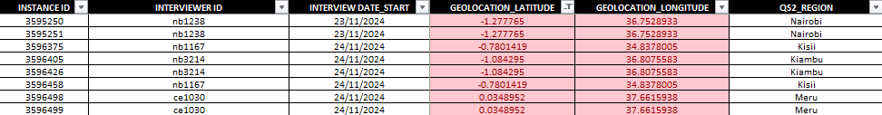
QUALITY FINDINGS
GPS Tracking
Accuracy of the data was ensured by validating the interview location.
Any instances of duplicate GPS coordinates flagged concerns about the authenticity of those interviews.
Interviews with missing and duplicate GPS were all subjected to cancellation.
Below shows a sample snippet for flagged instances;
Several interviews were flagged for missing and duplicated GPS coordinates, an indication that interviewers were submitting interviews in bulk instead of synchronizing and submitting immediately after completing each interview.
There is a need to have phones fully charged and teams facilitated with airtime early enough so that lack of airtime and depleted battery are not cited for bulk uploads of interviews.

Slide 19
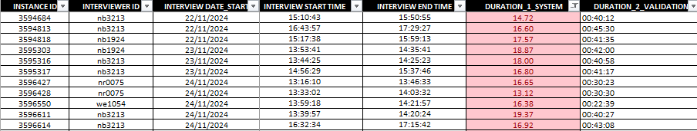
QUALITY FINDINGS
Interview Duration/LOI < 50 % & > 50% Average
This check flagged interviews that were significantly shorter or longer than expected.
Specifically, it identified the interviews that were less than half the average or more than double average active time.
Interviews with LOI below half the average were all subjected to cancellation.
27(twenty-seven) interviews were flagged due to discrepancies between the interview duration and the iField active LOI, where the start–end time exceeded the recorded active time, falling below the acceptable threshold.

Slide 20
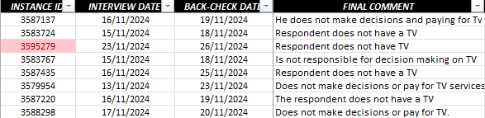
QUALITY FINDINGS
Wrong recruitment
From the telephonic back-checks, several respondents claimed not to own a TV, despite recruitment criteria requiring ownership of a Standard Box TV, Smart TV, or Flat Screen TV. This gave an impression that respondents can be either inconsistent or interviewers can fail to screen accordingly before engaging the respondents.
Below snapshots;
Telephonic Back-checks Outcome

Slide 21
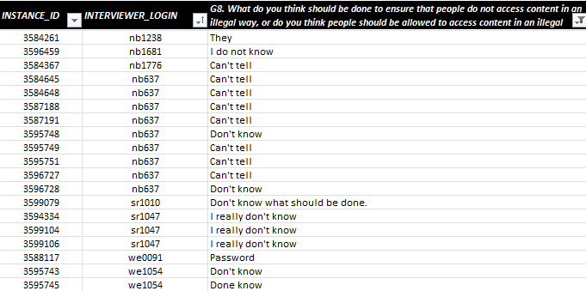
QUALITY FINDINGS
Verbatim
Interviewers were required to capture comprehensive feedback from respondents for all open-ended questions.
Most interviewers recorded relevant, complete, and accurate responses, which was commendable.
However, there were several instances of incomplete and vague verbatims, often recurring with specific interviewers.
Additionally, some verbatims were keyed in Swahili instead of English, contrary to the expected standards.

Slide 22
QUALITY ACHIEVEMENTS
Sample
Back-checks & Accompaniments
Duration(in minutes)
Back-checks Achieved: 24%
Completed Back-checks: 617
Effective Back-checks: 253 Target: 20%
Accompaniments Achieved: 30% Target: 20%
Average
35
Maximum
44
Minimum
26
Target
1000
Achieved
1019
19
10%
Quota Management
Listen-in
Mitigation
Quota management was done on the Ipsos’ proprietary field management system known as iField that has among other functionalities real-time quota tracking capability.
Target
11%
Target
10%
Held debrief sessions & checked improvements.
Listened in to the audio recorded interviews.
Interviewers with major issues were accompanied by Quality Control team.
Telephonic back-checks were done to affirm the interviews were conducted.
1%
Interview Variable Checks
Quality Queries
As a standard quality-checking procedure, all submitted interviews uploaded in the portal were subjected to validation on key metrics.
Queries were shared with the field coordinator for review and feedback.
Few mentions in other multi-mention questions.
Self administration by the interviewers.
Duplicate and missing GPS co-ordinates.
Inconsistencies in related questions.
LOI < 50% average.
Missing telephone numbers and audio recording.

Slide 23
ACHIEVEMENT PER REGION
As illustrated in the charts below, all quotas across all the regions achieved a balanced and representative sample size.
Achievements
REGIONS

Slide 24
ACHIEVEMENT PER INTERVIEWER
The graph depicts interviewer productivity, showing a range from the highest number of interviews conducted at 61 (sixty-one) to the lowest at 1 (one).
The average length of interview (LOI) differs widely, with averages ranging from 44 (forty-four) minutes to 26 (twenty-six) minutes.

Slide 25



FIELDWORK AND QUALITY CHECKS
Start date:13th, November 2024.
End date: 01st, December 2024.
19 Days
Fieldwork
Wholesomely, the Quality Control (QC) team managed to check key metrics on 100% of submitted interviews.
This was by conducting in-depth checks, audio listen-ins, and field and telephonic back-checks.
Quality Checking
Quotas were successfully met across all sampling points, ensuring representation of entire population in all the regions.
Approval was pegged on all the interviews adhering to the established Quality Control metrics.
Approval
Silhouette and image credits: Shutterstock.

Slide 26
CHALLENGES
05

Slide 27

CHALLENGES
In-field feedback required continuous prompting to ensure that all responses were consolidated effectively.
Most of the sampling points had poor network connectivity, making it difficult for interviewers to synchronize their devices. This led to backlogs and eventually resulted in duplicate GPS submissions during task completion.

Slide 28
recommendation
06

Slide 29

RECOMMENDATION
Establish clear timelines for feedback and ensure accountability from all parties involved to avoid delays in report consolidation.
Regulate interviewers’ productivity levels to mitigate risks and minimize the impact of data quality issues. This will help identify and address cases where an interviewer or a group of interviewers exhibit significantly higher productivity percentages, which may result in outlier data that could lead to the cancellation of interviews.
To prevent GPS issues, interviewers should pilot test devices for accuracy and functionality with at least two interviews.

Slide 30
All information received from the client for the purpose of this research will be treated with utmost confidentiality by Ipsos project team.
Every member of Ipsos involved in this study is committed to this policy and will under no circumstances share any information made available to Ipsos by the client, either in writing or verbally.
Ipsos respects client’s rights and will sign a confidentiality agreement for this project, if need be.
Quality assurance & data safety

Slide 31



Ipsos
Affiliations & certification
MSRA
ESOMAR
ISO
Ipsos Kenya is a key members the Market and Social Research Association of Kenya
MSRA is an industry regulating organization that was forged to drive quality assurance.
The world association for market, social and opinion research, unites a global membership of 4900 members from 130 countries.
The ESOMAR Membership mark signals an endorsement of ethical standards and provides a valued means of recognition within the wider marketing and research industries.
Our methods & practices are as per ISO. We are in compliance with ISO 20252:2019

Slide 32

ABOUT IPSOS
GAME CHANGERS
Ipsos is the third largest market research company in the world, present in 90 markets and employing more than 18,000 people.
Our research professionals, analysts and scientists have built unique multi-specialist capabilities that provide powerful insights into the actions, opinions and motivations of citizens, consumers, patients, customers or employees. Our 75 business solutions are based on primary data coming from our surveys, social media monitoring, and qualitative or observational techniques.
“Game Changers” – our tagline – summarises our ambition to help our 5,000 clients to navigate more easily our deeply changing world.
Founded in France in 1975, Ipsos is listed on the Euronext Paris since July 1st, 1999. The company is part of the SBF 120 and the Mid-60 index and is eligible for the Deferred Settlement Service (SRD).
ISIN code FR0000073298, Reuters ISOS.PA, Bloomberg IPS:FP
www.ipsos.com
In our world of rapid change, the need for reliable information to make confident decisions has never been greater.
At Ipsos we believe our clients need more than a data supplier, they need a partner who can produce accurate and relevant information and turn it into actionable truth.
This is why our passionately curious experts not only provide the most precise measurement, but shape it to provide True Understanding of Society, Markets and People.
To do this we use the best of science, technology and know-how and apply the principles of security, simplicity, speed and substance to everything we do.
So that our clients can act faster, smarter and bolder.
Ultimately, success comes down to a simple truth:
You act better when, you are sure.
Ipsos complies to ISO 20252 :2019 when executing a research project. Ipsos was certified by SGS United Kingdom Ltd, list of certified characteristics available upon request or on www.sgs.com/standard.

Slide 33
THANK YOU

